Slide 1
Representational state transfer (REST)

Slide 2
REST(REpresentational State Transfer)
REST is the protocol used for interaction with the Web from constrained devices.
The main aim of the REST was to simplify the web-application development and interaction.
It stipulates the following constraints on application development
Should be based on client-server architecture and the servers should be stateless
Support should be provided for caching at the client side
The interface to servers should be generic and standardized (URI)
Layering in the application architecture should be supported and each of the layers shall be independent
Optional code-on demand should be extended to clients having the capability

Slide 3
REST(REpresentational State Transfer)
These constraints, combined with the following principles, define the RESTful approach to application development
Everything on the Internet is a resource. The resources can be Text Files, Html Pages, Images, Videos or Dynamic Business Data.
Unique identifiers are available to identify the resources
Generic and simple interfaces are available to work with those resources
Communication between client and servers can be through representation of resources. For eg. A client can ask for JSON representation whereas another client may ask for XML representation of the same resource to the server and so on. It is the responsibility of the REST server to pass the client the resource in the format that the client understands
Resource representation through sequence of bytes is followed by some metadata explaining the organization of the data
Since transactions are stateless, all interactions should be context-free
Layering is supported, and hence intermediaries should be transparent

Slide 4
REST(REpresentational State Transfer)
The previous constraints and principles bring in many advantages to the distributed applications:
scalability, loose coupling, better security, simple addressability, connectedness, and performance.

Slide 5
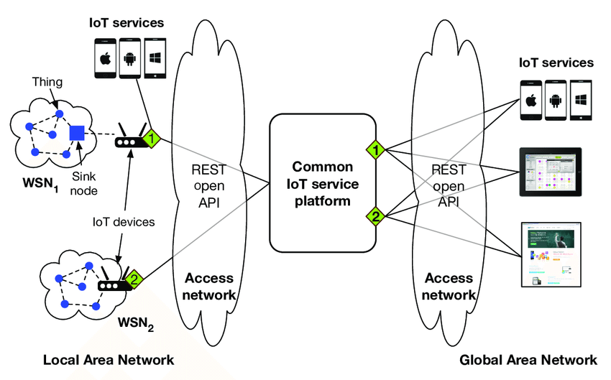
Requirements-of-providing-the-common-IoT-service-platform-and-REST-open-API-to-make-it

Slide 6
CoAP
Constrained Application Protocol (CoAP) is a specialized web transfer protocol for use with constrained nodes and constrained networks in the Internet of Things.
Application layer usually employ HTTP to provide web service, but HTTP has high computation complexity
CoAP is designed to enable simple, constrained devices to join the IoT even through constrained networks with low bandwidth and low availability. It is generally used for machine-to-machine (M2M) applications such as smart energy and building automation.

Slide 7
CoAP
It is optimized for constrained power and processing capabilities of IoT
In contrast to HTTP, CoAP exchanges messages asynchronously and uses UDP.
The CoAP has four types of messages: Acknowledgement, Reset, Confirmable (CON), and NonConfirmable (NON).
The non-confirmable messages are used to allow sending requests that may not require reliability. Reliability is provided by the message layer and will be activated when Confirmable messages are used.
The Request methods used in CoAP are: GET, POST, PUT, and DELETE of HTTP

Slide 8
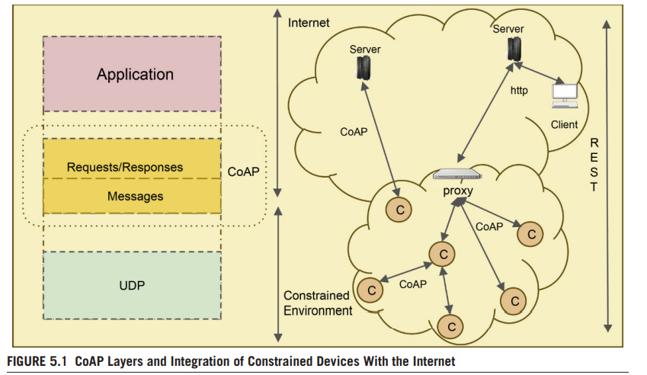
CoAP

Slide 9
Comparison of HTTP and CoAP
CoAP is more efficient for applications on smart objects, engaged in frequent communication sessions.
CoAP is cost-effective whenever the battery/power-source replacements prove costly
Whenever the charges for the data communication are volume-based, CoAP is found to be more cost-effective
CoAP has been found to be more beneficial cost-wise in push mode than in pull mode
CoAP is using similar features to HTTP but also allows for low overhead, multicast, etc.
HTTP is based on TCP protocol , But CoAP operates over UDP

Slide 10
Advantages of CoAP
A compact binary header (10–20 bytes), along with UDP, reduces the communication overhead, thereby reducing the delay and minimizing the power consumption due to data transmission.
Since asynchronous data push is supported, it enables things to send information only when there is a change of observed state. This allows the things to sleep most of the time and conserve power.
The minimal subset of REST requests supported by CoAP allows the protocol implementations to be less complex when compared to HTTP.
This lowers the hardware requirements for the smart things on which it executes

